Slide 1
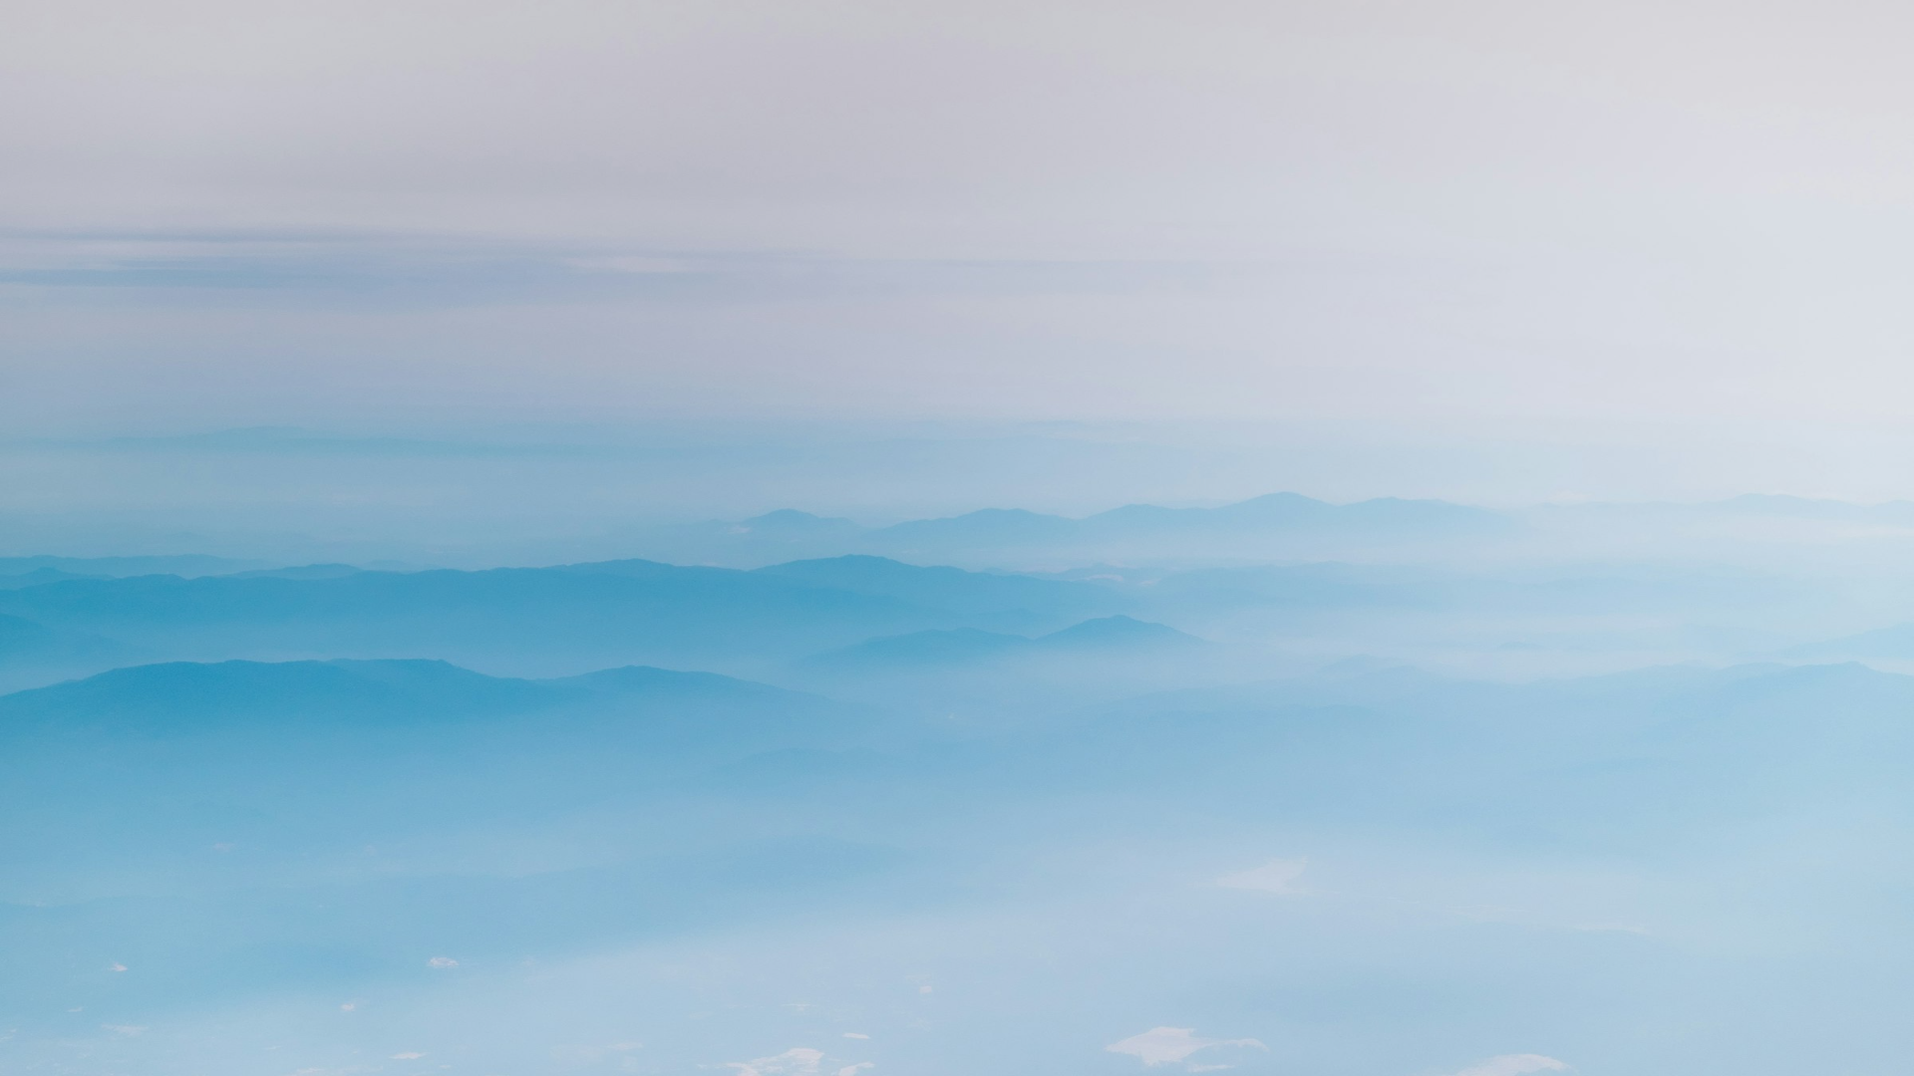
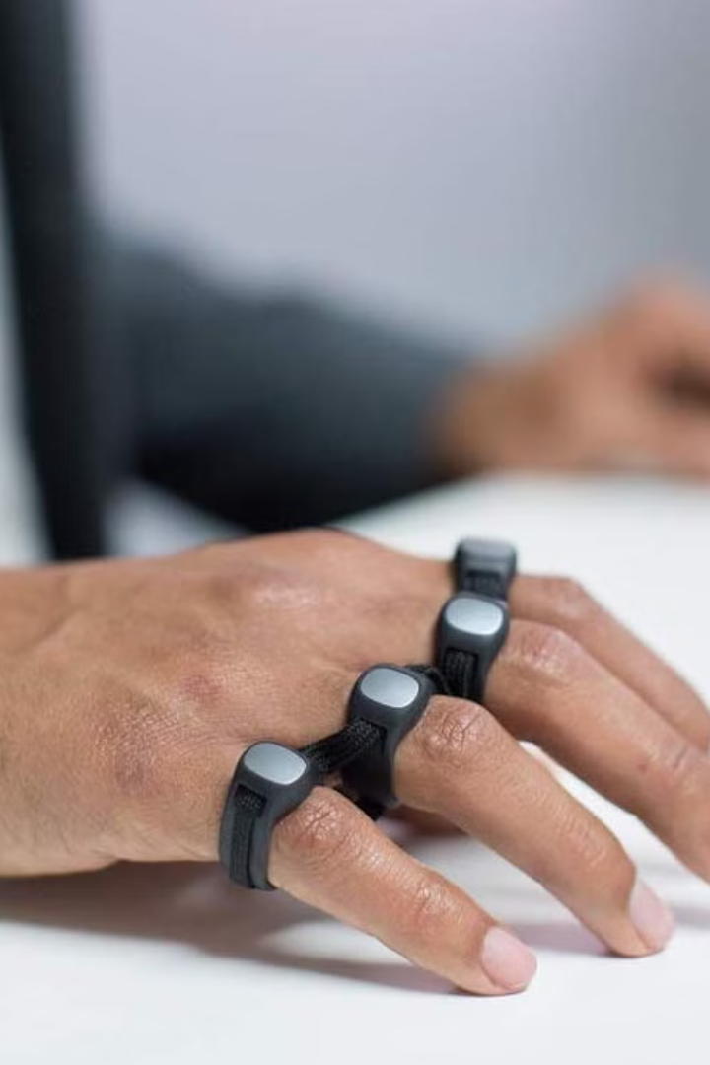
Hand Gesture Control System
Using MediaPipe, OpenCV, PyAutoGUI, Tkinter and PIL to create an innovative system for controlling devices through hand gestures.

Slide 2
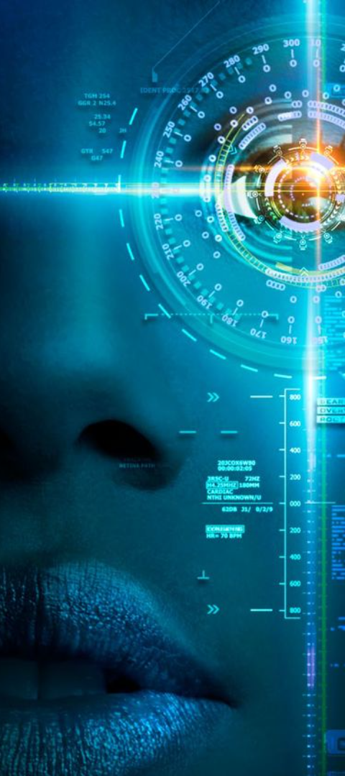
Computer Vision
Computer vision is a field of artificial intelligence that enables computers to interpret and understand visual information from the real world.
It involves tasks such as image recognition, object detection, and gesture tracking, which are essential for projects like the Hand Gesture Control System.

Slide 3
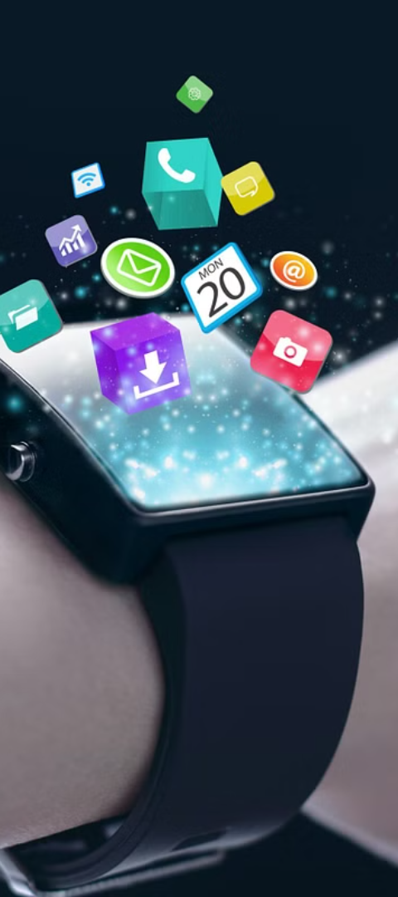
Introduction
The Hand Gesture Control System is an innovative project that utilizes computer vision techniques to control a computer using hand gestures.
This project aims to provide an intuitive and hands-free interface for interacting with computers, especially in scenarios where traditional input devices may not be feasible or convenient.

Slide 4
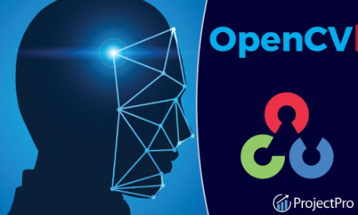
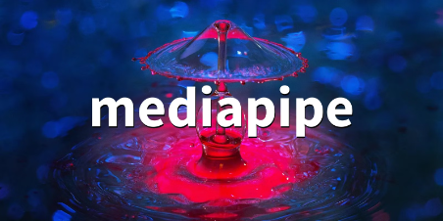
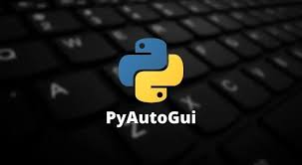
Technologies Used
MediaPipe
OpenCV
PyAutoGUI
A machine learning framework developed by Google that provides pre-built solutions for various computer vision tasks, including hand tracking.
A Python library that enables cross-platform automation of mouse and keyboard inputs, making it ideal for simulating user interactions in the Hand Gesture Control System.
An open-source computer vision and machine learning software library, providing various functions for real-time computer vision like image and video processing, including feature detection and object tracking.

Slide 5
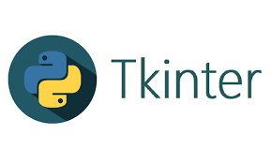
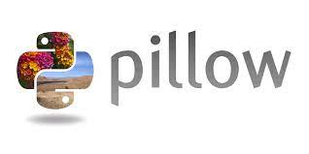
Tinkter
Python Imaging Library
A cross-platform widget toolkit that provides a library of basic elements of GUI widgets for building a graphical user interface (GUI) in many programming languages
PIL is a popular library for image processing in Python. It is used by a variety of applications, including web applications, desktop applications, and machine learning algorithms.

Slide 6

Project Overview
1
The Hand Gesture Control System captures live video feed from a webcam.
2
It uses MediaPipe to detect and track hand gestures in real-time.
3
OpenCV is employed for image processing tasks such as resizing, color conversion, and drawing overlays.
4
PyAutoGUI is utilized to simulate mouse movements and clicks based on detected hand gestures.

Slide 7
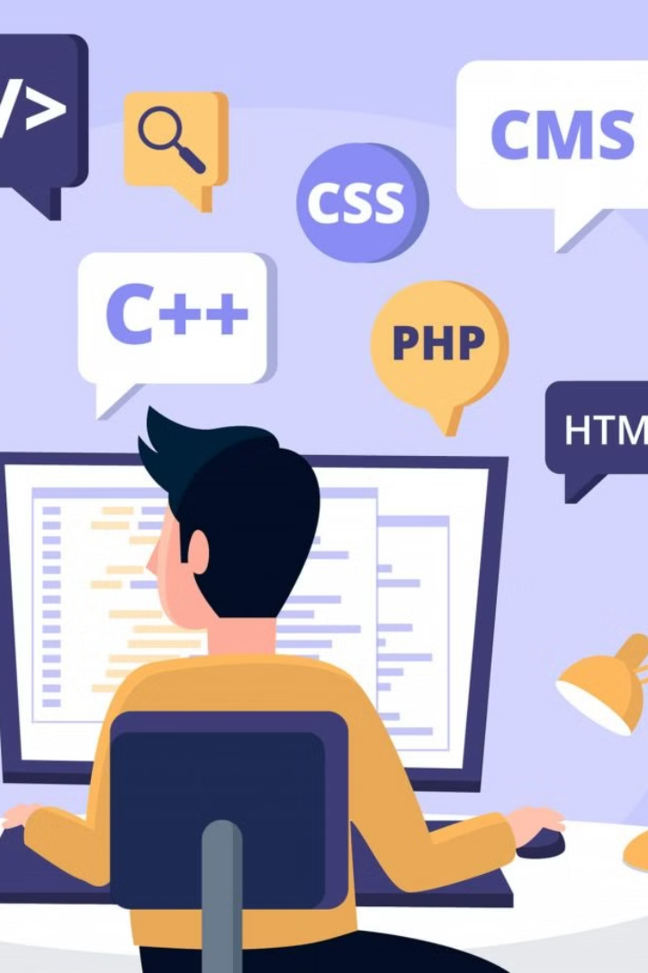
Code Implementation
The Python code for the Hand Gesture Control System is structured to continuously process frames from the webcam.
It integrates MediaPipe, OpenCV, PyAutoGUI, Tkinter and PIL libraries to perform hand gesture recognition and computer control functionalities.
Key components include hand tracking, gesture recognition, and mouse control based on detected gestures.

Slide 8
Advantages
1
Intuitive Interaction
2
Hands-free Operation
Users can control the computer using natural hand gestures, offering a more intuitive and immersive user experience.
The system eliminates the need for physical input devices such as keyboards and mice, making it suitable for scenarios where hands-free operation is desired.
3
Accessibility
The Hand Gesture Control System can benefit users with physical disabilities or mobility impairments by providing an alternative input method that does not require fine motor skills.

Slide 9
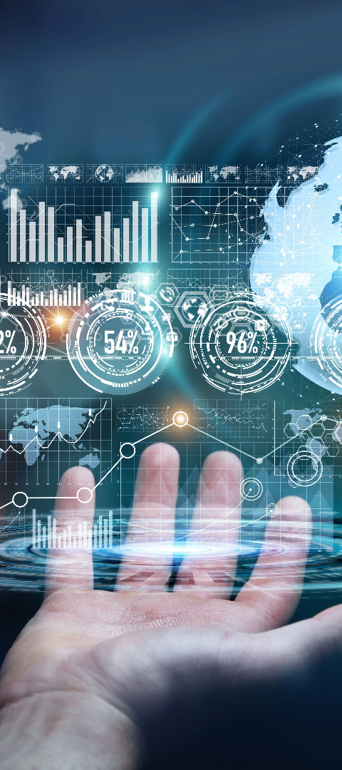
Future Improvements
1
Enhanced Gesture Recognition
2
User Interface Enhancement
Developing a graphical user interface (GUI) for configuring settings, calibrating gestures, and providing visual feedback to the user.
Improving the accuracy and robustness of gesture recognition algorithms to support a wider range of gestures and gestures in various environments.
3
Integration with Applications
Integrating the Hand Gesture Control System with specific applications such as presentations, media players, and games to enable hands-free interaction within those applications.

Slide 10
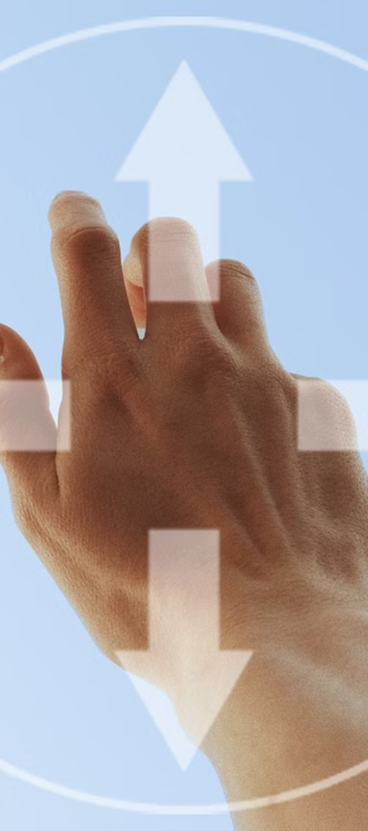
Conclusion
The Hand Gesture Control System demonstrates the potential of computer vision and gesture recognition technologies to revolutionize human-computer interaction.
By leveraging MediaPipe, OpenCV, PyAutoGUI, Tkinter and PIL libraries the project offers a hands-free and intuitive interface for controlling computers using natural hand gestures.

Slide 11

Thank you

